Slide 1
Overall Thoughts on Code
General Code Etiquette
There were several issues within the code that make it hard to understand its execution. These become important in the future for other reviews of the code and for any attempt to build more complex analysis based on this code. There was also no document explaining the code and the data, which is helpful and should be a part of every project.
Code Assumptions
The assumptions discussed in the presentation show the choices made for the model and how they effect the final result. Several of the models are built on regressions that are not statistically significant, make broad assumptions about the rate of future loans, and contain aggressive assumptions about the rate of job growth due to the loans given.
These decisions are intentional due to the current lack of data.
1

Slide 2
The Ideal Analysis
Ideal Data Collection
Analysis would be done only at the end of 2019 and would be backward looking
PFIs collect data on every loan distributed
A random sample of loans is surveyed at 2 points in time to get an accurate sense of job creation and other company metrics
A random sample of companies that did not receive funding in each country would be sampled as well
Jobs Added
Take the average difference in the number of employees per SME for each loan between the two survey points and multiply by the net change in portfolio
Jobs Supported
Take the average number of jobs at the baseline date and multiply by the net change in portfolio
Add in Jobs Added
Jobs Added as a Result of Financing
Using matching to partner PFI clients with unfinanced SMEs and run a regression comparing each group to understand the full effects of the loan given
2

Slide 3
Issues with the Ideal Analysis
Current Analysis
Forward looking analysis which requires estimates based on current data for 2015 through 2019
Loan Estimation
Loan portfolio information is unavailable for most PFIs (slide 5)
Only information for 20 out of 62 PFIs at two time points
Requires estimating loan difference per dollar of subsidy for AS and IS projects
Growth rates for the future number of loans must be estimated for 2016 – 2019 from the current number (slide 6)
Job Formulas
Only 2 sources of PFI client SMEs exist (FCMB and ABL)
These are used in place of the 2 time period surveys used in an ideal scenario
Supplemented with Enterprise Survey data for Jobs Added regressions rather than using the ideal matching
Jobs Added (slide 7)
Jobs Supported (slide 9)
Jobs Added as Result of Financing (slide 13)
3

Slide 4
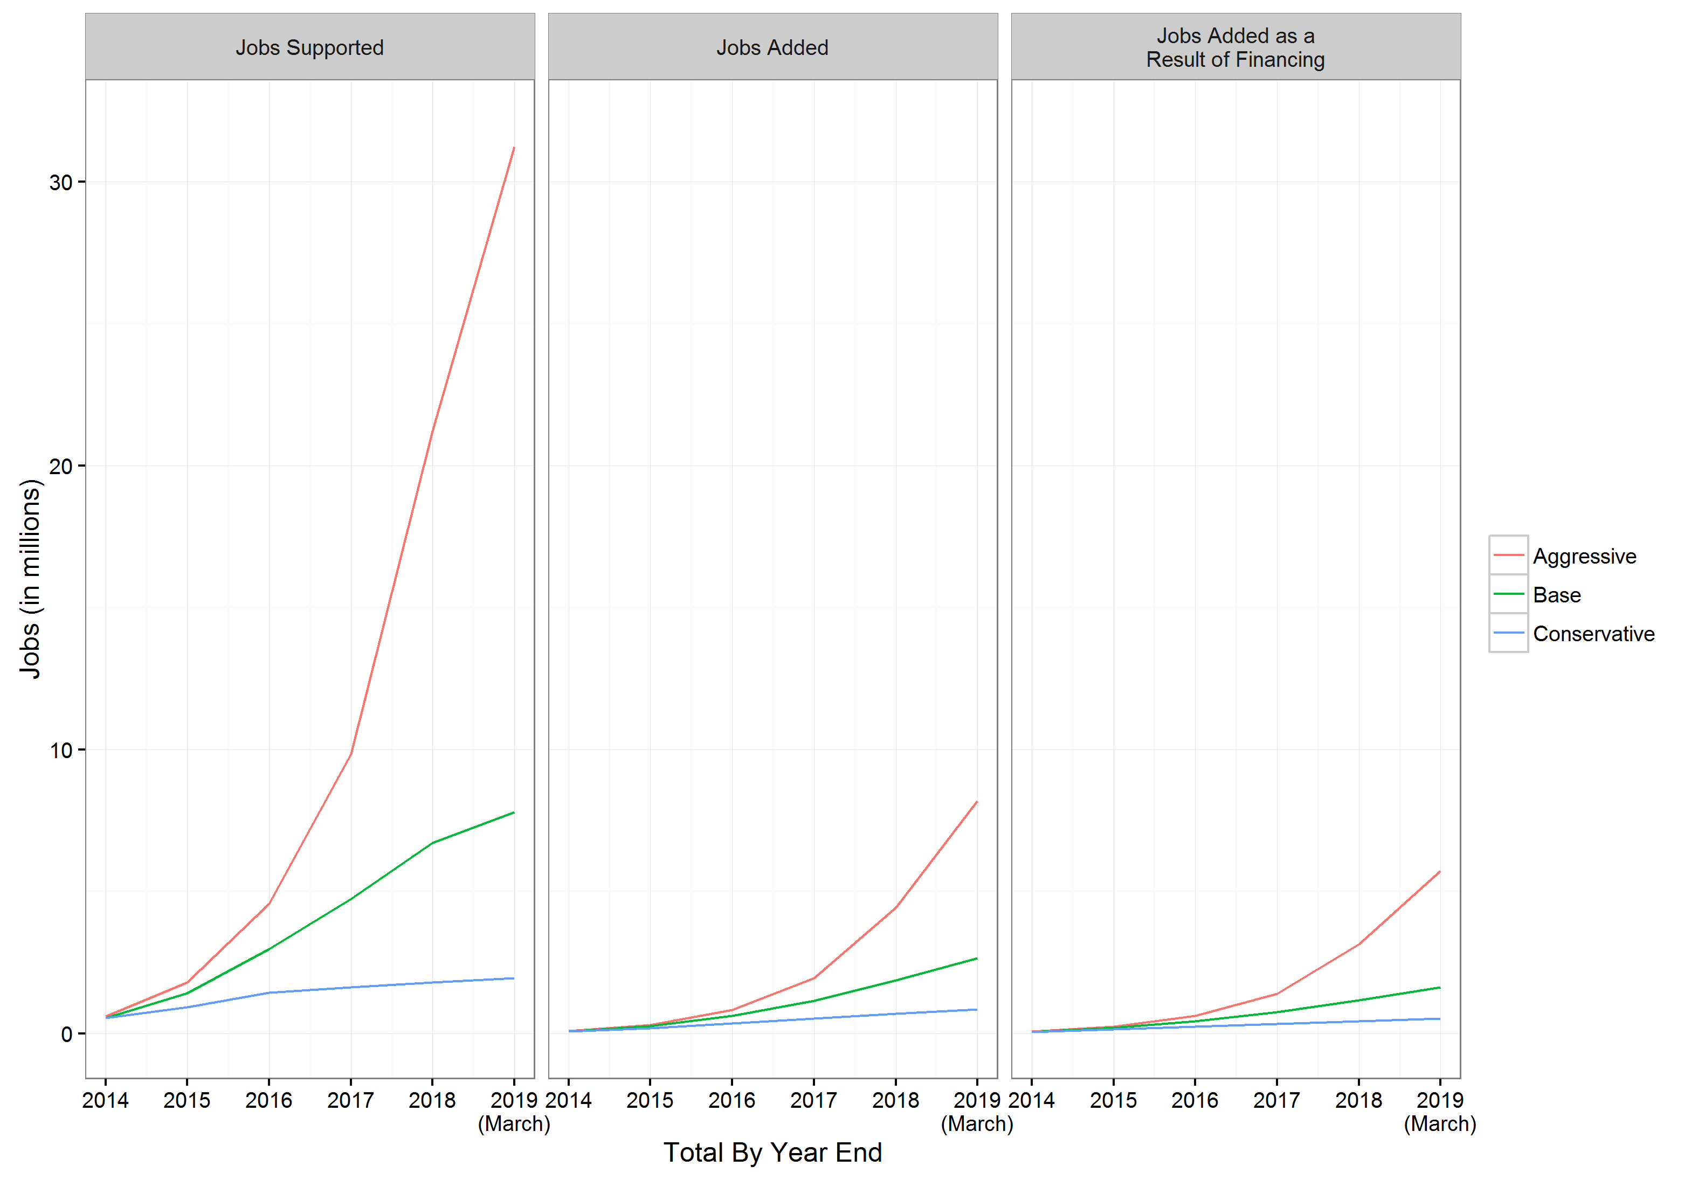
Resulting Code Architecture
Loan Portfolio Information for New Loans
Conservative (using only existing loans)
Baseline (using constant growth)
Aggressive (using CAGR)
Three Regressions
Jobs Supported
Jobs Added
Jobs as the Result of Financing
Two Charts
Growth rate under each scenario
Growth rate under each scenario
with confidence intervals
(This graph did not work
when I ran the code)
4

Slide 5
Loan Portfolio Information
Missing Loan Portfolio Information
Only information for 20 out of 62 PFIs at two time points
My calculation has it as 65 total banks
To create loan numbers for the missing observations, banks are split into
AS banks
30 observations, 12 with loan data
Other banks
35 observations, 11 with loan data
The means of the 20 observations are taken
The average number of loans and average loan amount are used for banks with missing portfolio information
The mean and median vary significantly due to a small data sample for each group and the presence of outliers. The current formula uses the means, but this is overestimating the number and amount of the overall loans. It’s worth considering the median as a more accurate estimate for the small dataset.
5

Slide 6
Estimating the Change in Portfolio
Assumptions in New Loan Equations
Banks without Loan information take the number estimated in the last slide, depending on if they are AS or Other banks
All 3 scenarios assume the new loan rate falls to 25% of the yearly total in 2019
The conservative forecast assumes that the only loans made are current existing loans
The baseline forecast assumes constant loan growth
Constant growth is given by the ‘loan.diff.annual’ column in the ‘pfi’ dataset
The aggressive forecast assumes CAGR to estimate loan growth
6

Slide 7
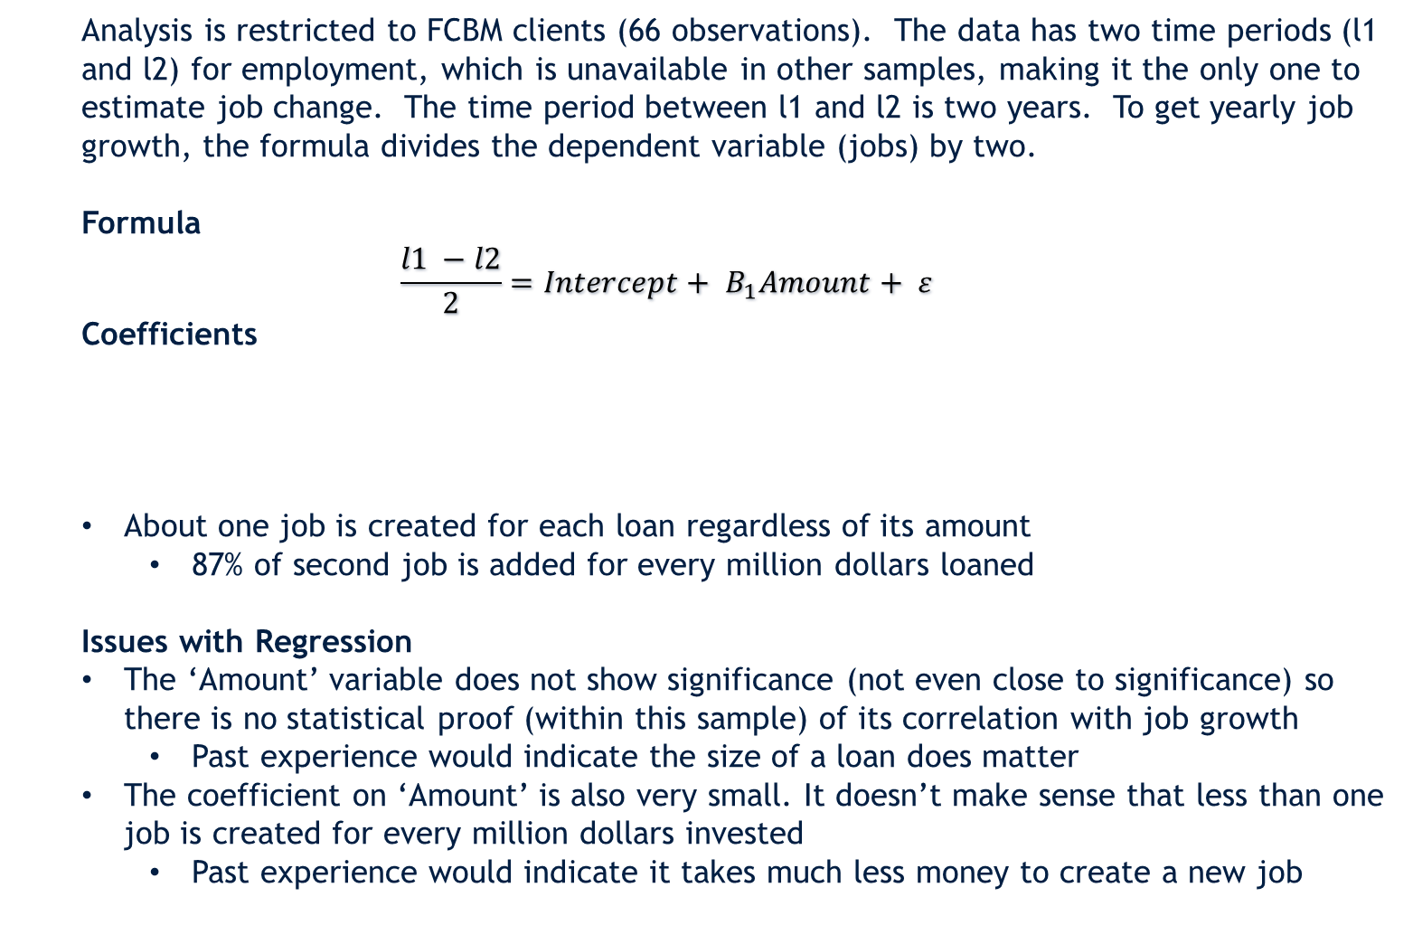
Jobs Added Regression
Analysis is restricted to FCBM clients (66 observations). The data has two time periods (l1 and l2) for employment, which is unavailable in other samples, making it the only one to estimate job change. The time period between l1 and l2 is two years. To get yearly job growth, the formula divides the dependent variable (jobs) by two.
Formula
$$\frac{l1 −l2}{2}=Intercept+ B_{1}Amount+ ε$$
Coefficients
About one job is created for each loan regardless of its amount
87% of second job is added for every million dollars loaned
Issues with Regression
The ‘Amount’ variable does not show significance (not even close to significance) so there is no statistical proof (within this sample) of its correlation with job growth
Past experience would indicate the size of a loan does matter
The coefficient on ‘Amount’ is also very small. It doesn’t make sense that less than one job is created for every million dollars invested
Past experience would indicate it takes much less money to create a new job
7

Slide 8
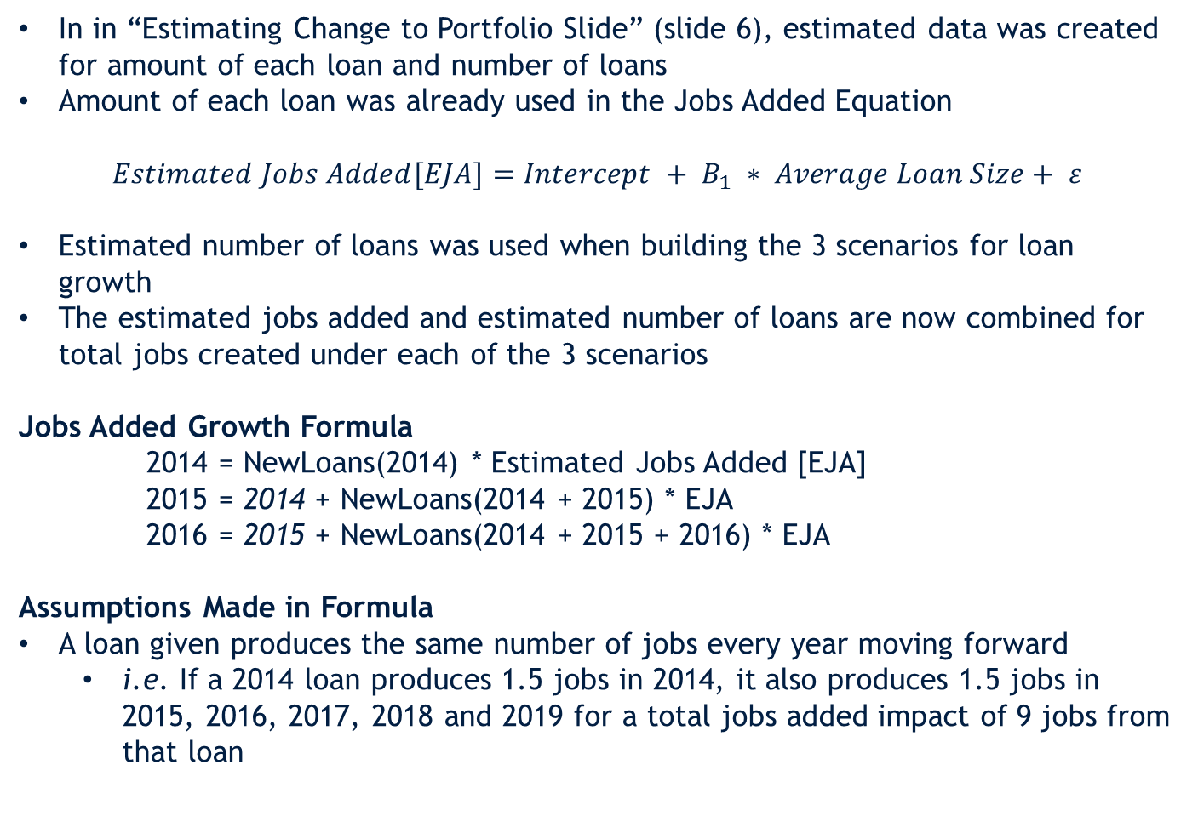
Integration of Estimated Data with Estimated Regression
In in “Estimating Change to Portfolio Slide” (slide 6), estimated data was created for amount of each loan and number of loans
Amount of each loan was already used in the Jobs Added Equation
$$Estimated Jobs Added[EJA]=Intercept + B_{1} ∗ Average Loan Size+ ε$$
Estimated number of loans was used when building the 3 scenarios for loan growth
The estimated jobs added and estimated number of loans are now combined for total jobs created under each of the 3 scenarios
Jobs Added Growth Formula
2014 = NewLoans(2014) * Estimated Jobs Added [EJA]
2015 = 2014 + NewLoans(2014 + 2015) * EJA
2016 = 2015 + NewLoans(2014 + 2015 + 2016) * EJA
Assumptions Made in Formula
A loan given produces the same number of jobs every year moving forward
i.e. If a 2014 loan produces 1.5 jobs in 2014, it also produces 1.5 jobs in 2015, 2016, 2017, 2018 and 2019 for a total jobs added impact of 9 jobs from that loan
Note: NewLoans is the amount determined in the 3 loan table scenarios. The job growth formula is the same for all 3 loan tables, but the number of loans changes to affect overall job growth
8

Slide 9
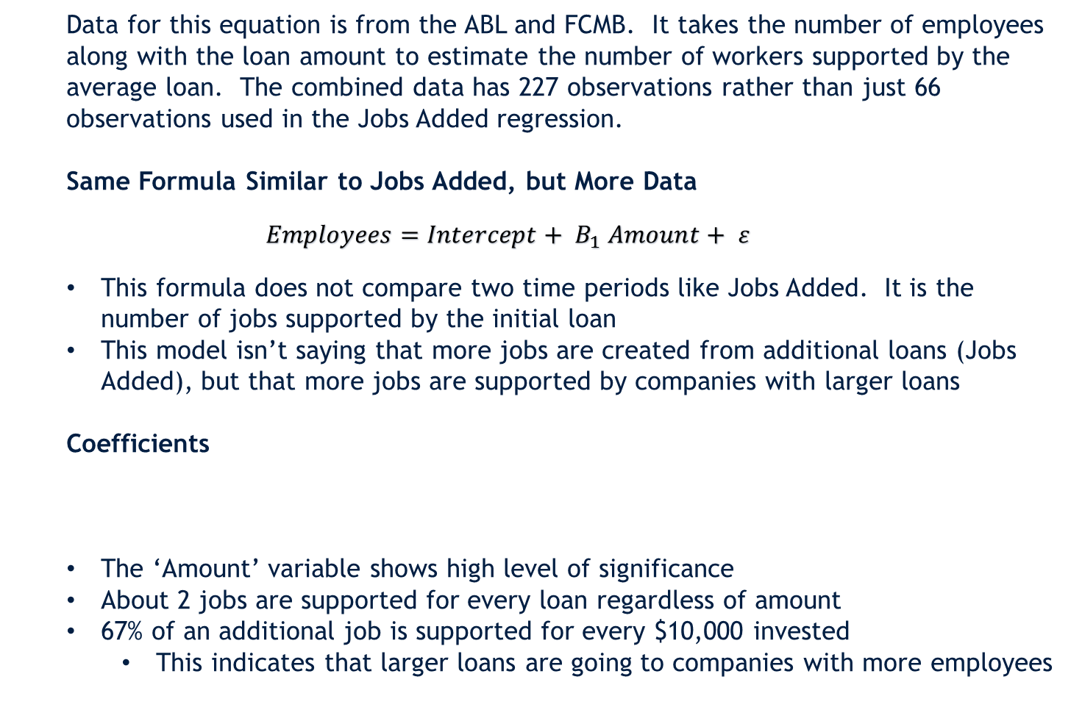
Jobs Supported Regression
Data for this equation is from the ABL and FCMB. It takes the number of employees along with the loan amount to estimate the number of workers supported by the average loan. The combined data has 227 observations rather than just 66 observations used in the Jobs Added regression.
Same Formula Similar to Jobs Added, but More Data
$$Employees=Intercept+ B_{1} Amount+ ε$$
This formula does not compare two time periods like Jobs Added. It is the number of jobs supported by the initial loan
This model isn’t saying that more jobs are created from additional loans (Jobs Added), but that more jobs are supported by companies with larger loans
Coefficients
The ‘Amount’ variable shows high level of significance
About 2 jobs are supported for every loan regardless of amount
67% of an additional job is supported for every $10,000 invested
This indicates that larger loans are going to companies with more employees
9

Slide 10
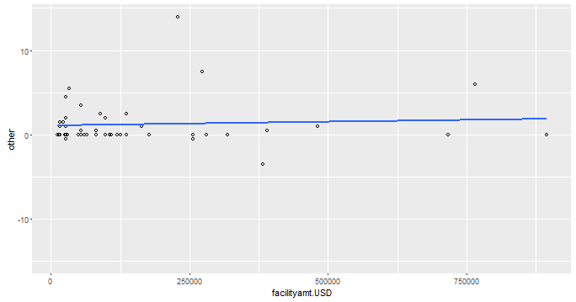
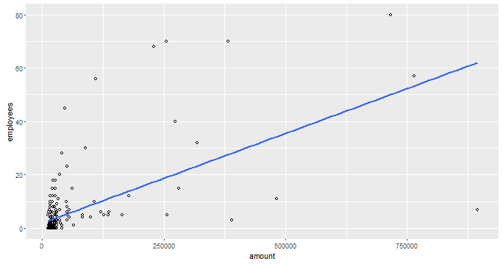
Plotted Regressions- Jobs Added(Top), Jobs Supported (Bottom)
10

Slide 11
Jobs Supported Growth Compared to Jobs Added
Jobs Added Growth Formula
2014 = NewLoans(2014) * Estimated Jobs Added [EJA]
2015 = 2014 + NewLoans(2014 + 2015) * EJA
2016 = 2015 + NewLoans(2014 + 2015 + 2016) * EJA
Jobs Supported Growth Formula
2014 = NewLoans(2014) * Estimated Jobs Added [EJA] +
NewLoans(2014) * Estimated Jobs Supported [EJS]
2015 = 2014 + NewLoans(2014 + 2015) * EJA + NewLoans(2015) * EJS
2016 = 2015 + NewLoans(2014 + 2015 +2016) * EJA +
NewLoans(2016) * EJS
Assumptions Made in Formula
The Jobs Added assumption is the same
Additional jobs are added for every year after the loan is given
Job Supported numbers are a constant growth from the new loans data
11

Slide 12
Potential Issues - Jobs Supported
There are two potential issues with the jobs supported data used. One may undercount the number of jobs supported and the other may be over counting.
ABL Data
Within the ABL data, there are a number of companies that have zero listed as the total number of employees. Some of these loans are fairly large, which would indicate that there are actually employees at these firms
One example is a shoes company with a $27,000 loan and no employees
FCMB Data
The information taken from this dataset is amount of the loan and the number of jobs (l1). However, the jobs added formula was l1 – l2, which implies that l1 was the second point in time after the loan had already been given and new jobs were added
l2 should be used since it is the original number of jobs supported by the loan
New Coefficients Old Coefficients
12

Slide 13
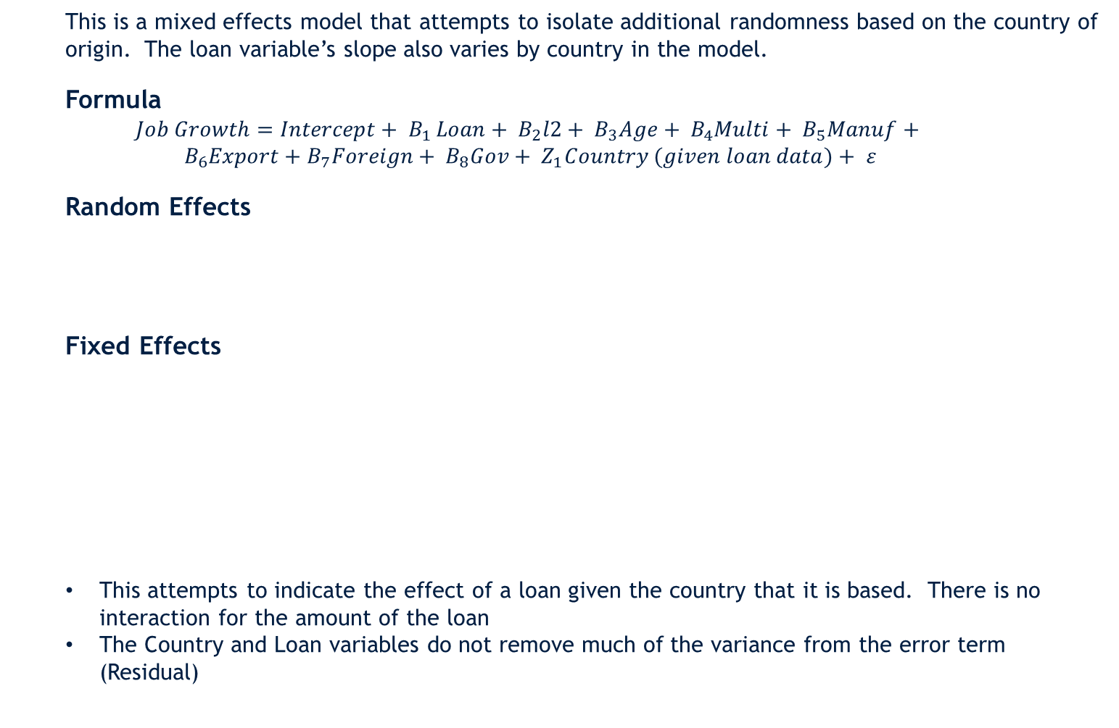
Jobs Added from Financing
This is a mixed effects model that attempts to isolate additional randomness based on the country of origin. The loan variable’s slope also varies by country in the model.
Formula
$$Job Growth=Intercept+ B_{1 }Loan+ B_{2}l2+ B_{3}Age+ B_{4}Multi+ B_{5}Manuf+$$
$$B_{6}Export+B_{7}Foreign+ B_{8}Gov+ Z_{1}Country (given loan data)+ ε$$
Random Effects
Fixed Effects
This attempts to indicate the effect of a loan given the country that it is based. There is no interaction for the amount of the loan
The Country and Loan variables do not remove much of the variance from the error term (Residual)
13

Slide 14
Enterprise Surveys
Much of the enterprise survey information has been incorporated into the Jobs Added from Financing formula. However, additional information could be added to better isolate the impact of finance.
Information Currently Used
Country
Loan Amount
Age of Firm
Industry
Manufacturing
Service
Exporting of the firm
Government ownership
Multinational (?)
Additional Information Available
Amount of Loan
Most recent and current
outstanding loan
Sales and Revenue Growth
Infrastructure Issues
Power Outages
Ownership Female
14

Slide 15
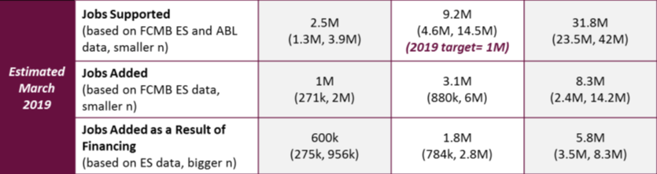
Finalized Sum of Equations and New Loan Assumptions
15

Slide 16
General Code Etiquette
Poorly written code can still work just fine. The computer program can keep track of disparate parts of information as long as the commands all reference something already established. However, code is not only written to be used by the computer, it needs to be written so that future coders can quickly identify what decisions and assumptions were made within the existing code. To help with this, there are general guidelines that code writers use to help future coders (or even themselves if they are looking back on their work months after completion). This code does not follow a number of these guidelines.
Stylistic Issues within Current Code
Included is a rough equivalent in a typical piece of writing.
Variables were introduced and not used immediately
This is like writing an introduction sentence to a paragraph, changing the subject, then referring to the sentence three paragraphs later
A lot of the code was not written within the same screen frame
This leads to scrolling right and left in the code rather than just scrolling vertically
Code was repetitive
This is like repeating the same information twice or three times in the same document
Issue with Repeatability of Code
Rows were sometimes deleted not by name, but by place in the data. This makes the code hard to use on future datasets where information is in a different order
16

